Slide 1

Week 3 Lecture 3 and 4
Network Design

Slide 2
Network Design

Slide 3

Topology
A branch of mathematics concerned with those properties of geometric configurations that are unaltered by elastic deformations such as stretching or twisting
A term used in the computer networking field to describe the structure of a network
The cisco three tier model is a logical topology of the network.
The network blueprint.

Slide 4
How Do You Know When You Have a Good Design?

Slide 5
How Do You Know When You Have a Good Design?
When you already know how to add a new building, floor, WAN link, remote site, e-commerce service, and so on
When new additions cause only local change, to the directly-connected devices
When your network can double or triple in size without major design changes
When troubleshooting is easy because there are no complex protocol interactions to wrap your brain around
Notes:
Said by Dr. Peter Welcher, consultant and author of many networking articles in magazines, etc.

Slide 6
Top-Down Network Design
Network design should be a complete process that matches business needs to available technology to deliver a system that will maximize an organization’s success.
In the LAN area it is more than just buying a few devices.
In the WAN area it is more than just calling the phone company.

Slide 7
Two Scenarios for design
Existing Network Infrastructure(NI)
New Network Infrastructure

Slide 8
Working with Existing NI
When working on existing network consider the following
Some changes will impact the entire network?

Slide 9
For example: Improving the efficiency of network addressing or routing protocol changes
Integrating new security measures
Adding new network services, such as voice traffic

Slide 10
Working with Existing NI
Impacting a Portion of the Network

Slide 11
Improving Internet connectivity and adding bandwidth
Updating access layer LAN cabling
Providing redundancy for key services
Supporting wireless access in defined areas
Upgrading WAN bandwidth

Slide 12
Top-Down Network Design Steps
Analyze requirements
Monitor and optimize network performance
Develop logical design
Implement and test network
Develop physical design
Test, optimize, and document design

Slide 13
Network Design Steps
Phase 1 – Analyze Requirements
Analyze business goals and constraints. How?
Analyze technical goals and tradeoffs
Characterize the existing network if any
Characterize network traffic

Slide 14
Network Design Steps
Phase 2 – Logical Network Design
Design a network topology (Today)
Design models for addressing and naming.
Why is it important?
Select switching and routing protocols
Develop network security strategies
Develop network management strategies

Slide 15
Network Design Steps
Phase 3 – Physical Network Design
Select technologies and devices for campus networks
Select technologies and devices for enterprise networks

Slide 16
Network Design Steps
Phase 4 – Testing, Optimizing, and Documenting the Network Design
Test the network design & how?
Optimize the network design how?
Document the network design & why?

Slide 17
Business Constraints
Budget
Staffing
Schedule
Politics and policies

Slide 18
Making Tradeoffs
Scalability 20
Availability 30
Network performance 15
Security 5
Manageability 5
Usability 5
Adaptability 5
Affordability 15
Total (must add up to 100) 100
You will always face constraints while designing the network. Depending upon situations you will have to adjust this table

Slide 19
Cisco Three Tier Model
Originally applied to switched networks
Now apply to all different kinds of networks

Slide 20
When to use it?
Small company.. Approx. 30 nodes one branch office?

Slide 21
Why Use a Hierarchical Model?

Slide 22
Why Use a Hierarchical Model?
Reduces workload on network devices
Avoids devices having to communicate with too many other devices (reduces “CPU adjacencies”)
Constrains broadcast domains
Enhances simplicity and understanding
Facilitates changes
Facilitates scaling to a larger size

Slide 23
Cisco’s Hierarchical Design Model
A core layer of high-end routers and switches that are optimized for availability and speed.
A distribution layer of routers and switches that implement policies and segment traffic
An access layer that connects users via hubs, switches, and other devices

Slide 24
Question
What happens if we implement policies at the core layer?

Slide 25
Network Topology Design Themes
Hierarchy
Redundancy
Modularity
Well-defined entries and exits

Slide 26
Hierarchical Network Design
Enterprise WAN
Backbone
Core Layer
Campus A
Campus B
Campus C
Distribution Layer
Campus C Backbone
Access Layer
Building C-1
Building C-2
Image from top down network design 2nd ed by Priscilla Oppenheimer

Slide 27
Flat Versus Hierarchy
Headquarters in Medford
Headquarters in Medford
Grants Pass Branch Office
Klamath Falls Branch Office
Ashland Branch Office
Grants Pass Branch Office
Klamath Falls Branch Office
Ashland Branch Office
White City Branch Office
Flat Loop Topology
Hierarchical Redundant Topology
Image from top down network design 2nd ed by Priscilla Oppenheimer

Slide 28
Flat Topology

Slide 29
Mesh Designs
Partial-Mesh Topology
Full-Mesh Topology
Image from top down network design 2nd ed by Priscilla Oppenheimer

Slide 30
A Partial-Mesh Hierarchical Design
Headquarters (Core Layer)
Regional Offices (Distribution Layer)
Branch Offices (Access Layer)
Image from top down network design 2nd ed by Priscilla Oppenheimer

Slide 31
Avoid Chains and Backdoors
Core Layer
Distribution Layer
Access Layer
Backdoor
Chain
Image from top down network design 2nd ed by Priscilla Oppenheimer

Slide 32
99.999% Availability May Require Triple Redundancy
ISP 1
ISP 2
ISP 3
Enterprise
Can the customer afford this?
This slide is not meant to be a design recommendation. Its for the purpose of discussion
Image from top down network design 2nd ed by Priscilla Oppenheimer

Slide 33
Availability Downtime in Minutes
Per Hour
Per Day
Per Week
Per Year
99.999%
.0006
.01
.10
5
99.98%
.012
.29
2
105
99.95%
.03
.72
5
263
99.90%
.06
1.44
10
526
99.70%
.18
4.32
30
1577
Table from top down network design 2nd ed by Priscilla Oppenheimer

Slide 34
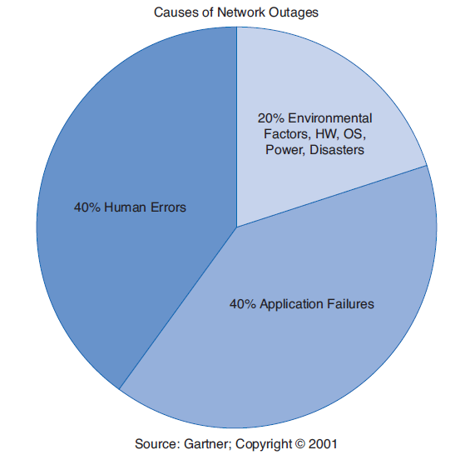
Triple redundancy ?

Slide 35
Conclusion

Slide 36
Reference
Top-Down Network Design 2nd edition
By Priscilla Oppenheimer

